Slide 1
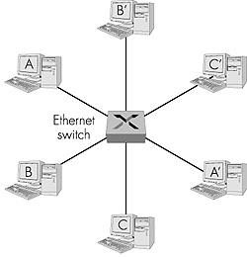
Ethernet Switches
layer 2 (frame) forwarding, filtering using LAN addresses
Switching: A-to-B and A’-to-B’ simultaneously, no collisions
large number of interfaces
often: individual hosts, star-connected into switch
  Ethernet, but no collisions!

Slide 2
Ethernet Switches
cut-through switching: frame forwarded from input to output port without awaiting for assembly of entire frame
  slight reduction in latency
combinations of shared/dedicated, 10/100/1000 Mbps interfaces

Slide 3
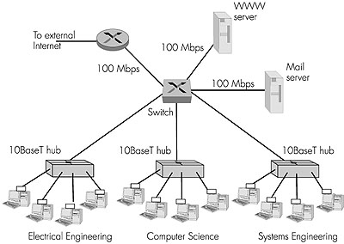
Ethernet Switches (more)
Dedicated
Shared

Slide 4
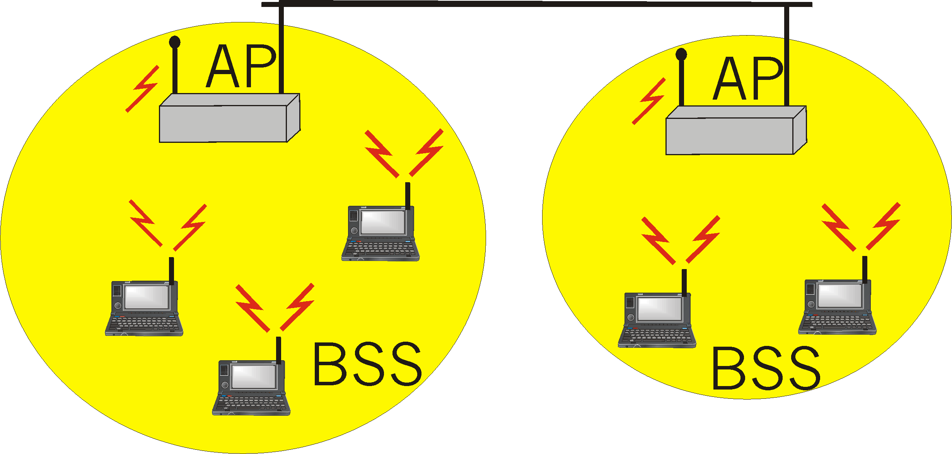
IEEE 802.11 Wireless LAN
wireless LANs: untethered (often mobile) networking
IEEE 802.11 standard:
  MAC protocol
  unlicensed frequency spectrum: 900Mhz, 2.4Ghz
Basic Service Set (BSS) (a.k.a. “cell”) contains:
  wireless hosts
  access point (AP): base station
BSS’s combined to form distribution system (DS)

Slide 5
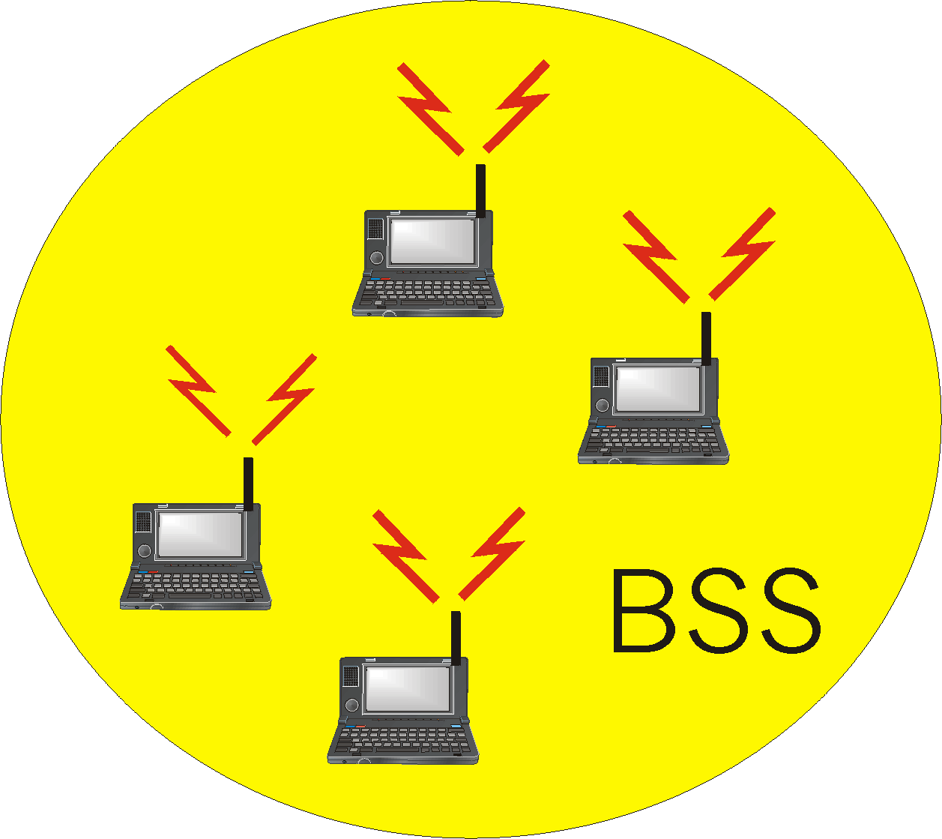
Ad Hoc Networks
Ad hoc network: IEEE 802.11 stations can dynamically form network without AP
Applications:
  “laptop” meeting in conference room, car
  interconnection of “personal” devices
  battlefield
IETF MANET
(Mobile Ad hoc Networks)
working group

Slide 6
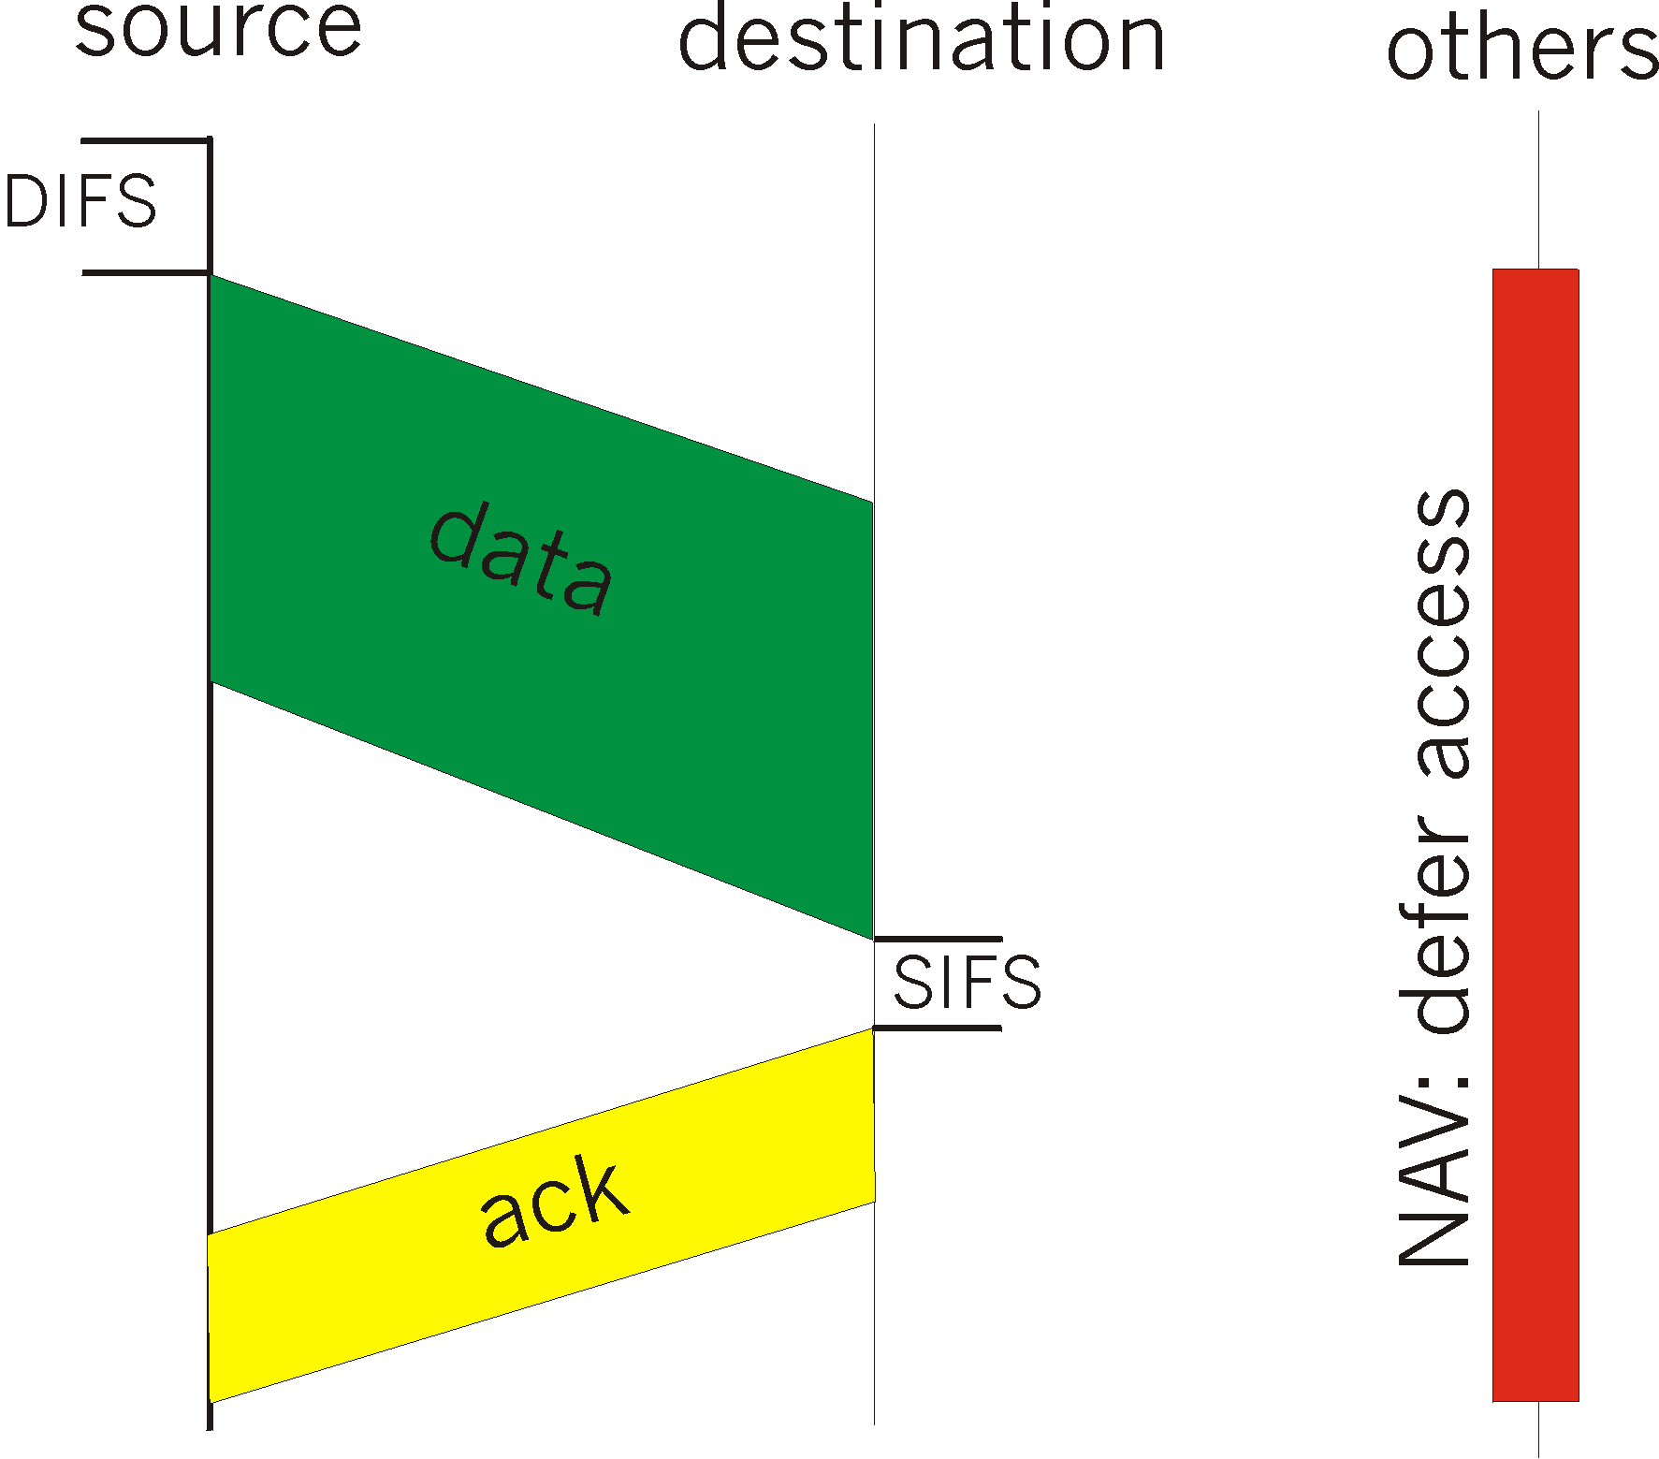
IEEE 802.11 MAC Protocol: CSMA/CA
802.11 CSMA: sender
- if sense channel idle for DISF sec.
then transmit entire frame (no collision detection)
-if sense channel busy
then binary backoff
802.11 CSMA receiver:
if received OK
return ACK after SIFS

Slide 7
IEEE 802.11 MAC Protocol
802.11 CSMA Protocol: others
NAV: Network Allocation
Vector
802.11 frame has transmission time field
others (hearing sata) defer access for NAV time units

Slide 8
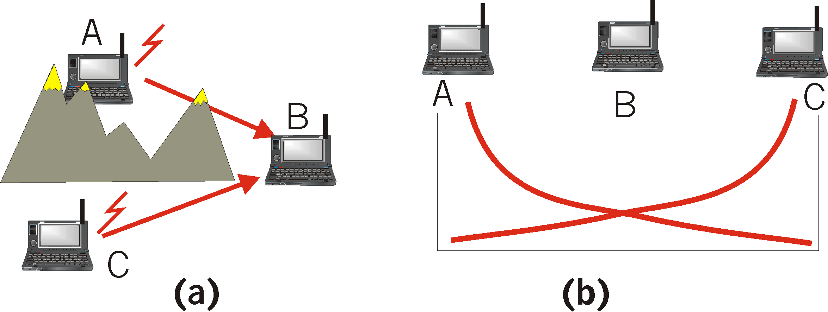
Hidden Terminal effect
hidden terminals: A, C cannot hear each other
  obstacles, signal attenuation
  collisions at B
goal: avoid collisions at B
CSMA/CA: CSMA with Collision Avoidance

Slide 9
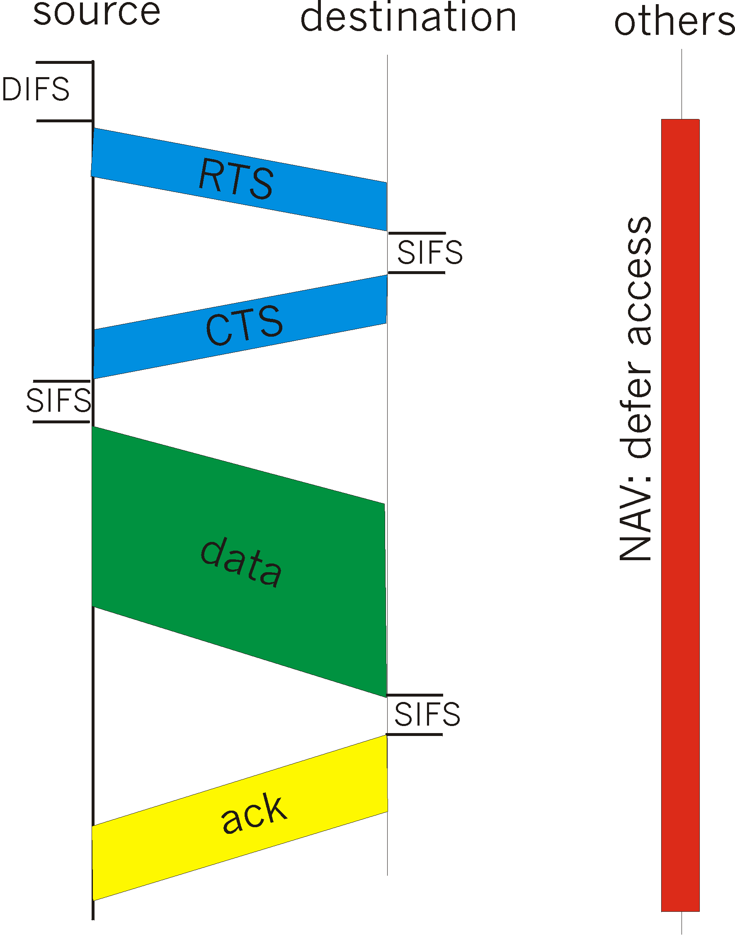
Collision Avoidance: RTS-CTS exchange
CSMA/CA: explicit channel reservation
  sender: send short RTS: request to send
  receiver: reply with short CTS: clear to send
CTS reserves channel for sender, notifying (possibly hidden) stations
avoid hidden station collisions

Slide 10
Collision Avoidance: RTS-CTS exchange
RTS and CTS short:
  collisions less likely, of shorter duration
  end result similar to collision detection
IEEE 802.11 alows:
  CSMA
  CSMA/CA: reservations
  polling from AP

Slide 11
Point to Point Data Link Control
one sender, one receiver, one link: easier than broadcast link:
  no Media Access Control
  no need for explicit MAC addressing
  e.g., dialup link, ISDN line
popular point-to-point DLC protocols:
  PPP (point-to-point protocol)
  HDLC: High level data link control (Data link used to be considered “high layer” in protocol stack!

Slide 12
PPP Design Requirements [RFC 1557]
packet framing: encapsulation of network-layer datagram in data link frame
  carry network layer data of any network layer protocol (not just IP) at same time
  ability to demultiplex upwards
bit transparency: must carry any bit pattern in the data field
error detection (no correction)
connection livenes: detect, signal link failure to network layer
network layer address negotiation: endpoint can learn/configure each other’s network address

Slide 13
PPP non-requirements
no error correction/recovery
no flow control
out of order delivery OK
no need to support multipoint links (e.g., polling)
Error recovery, flow control, data re-ordering
all relegated to higher layers!|

Slide 14

PPP Data Frame
Flag: delimiter (framing)
Address: does nothing (only one option)
Control: does nothing; in the future possible multiple control fields
Protocol: upper layer protocol to which frame delivered (eg, PPP-LCP, IP, IPCP, etc)

Slide 15
PPP Data Frame
info: upper layer data being carried
check: cyclic redundancy check for error detection

Slide 16
Byte Stuffing
“data transparency” requirement: data field must be allowed to include flag pattern <01111110>
  Q: is received <01111110> data or flag?
Sender: adds (“stuffs”) extra < 01111110> byte after each < 01111110> data byte
Receiver:
  two 01111110 bytes in a row: discard first byte, continue data reception
  single 01111110: flag byte

Slide 17

Byte Stuffing
flag byte
pattern
in data
to send
flag byte pattern plus
stuffed byte in transmitted data

Slide 18

PPP Data Control Protocol
Before exchanging network-layer data, data link peers must
configure PPP link (max. frame length, authentication)
learn/configure network
layer information
  for IP: carry IP Control Protocol (IPCP) msgs (protocol field: 8021) to configure/learn IP address

Slide 19
Chapter 5: Summary
principles behind data link layer services:
  error detection, correction
  sharing a broadcast channel: multiple access
  link layer addressing, ARP
various link layer technologies
  Ethernet
  hubs, bridges, switches
  IEEE 802.11 LANs
  PPP
journey down the protocol stack now OVER!
  Next stops: security, network management

